Slide 1
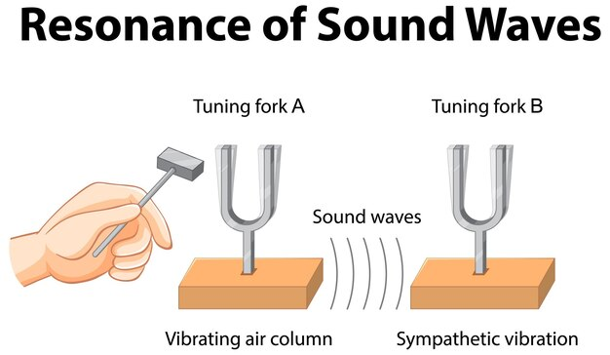
“To verify the laws of transverse vibration of strings and to determine the frequency of a tuning fork by Melde’s experiment”

Slide 2
Presented By
Name | ID
1. Md. Tawfiqul Islam Tamal | 23-52978-3
2. Md. Jarifur Rahman | 23-55463-3
3. Aftabul Kanzan | 23-55305-3
4. Dipro | 23-50440-1
5. Samiul Alim Siam | 23-55309-3

Slide 3
Table of Contents
01
02
03
04
Theory
05
Analysis and Calculation
Apparatus
06
Result
Procedure
07
Discussion
Experimental Data
08
Resources
Notes:
Here is our table of contents of our presentation

Slide 4
01
Theory

Slide 5

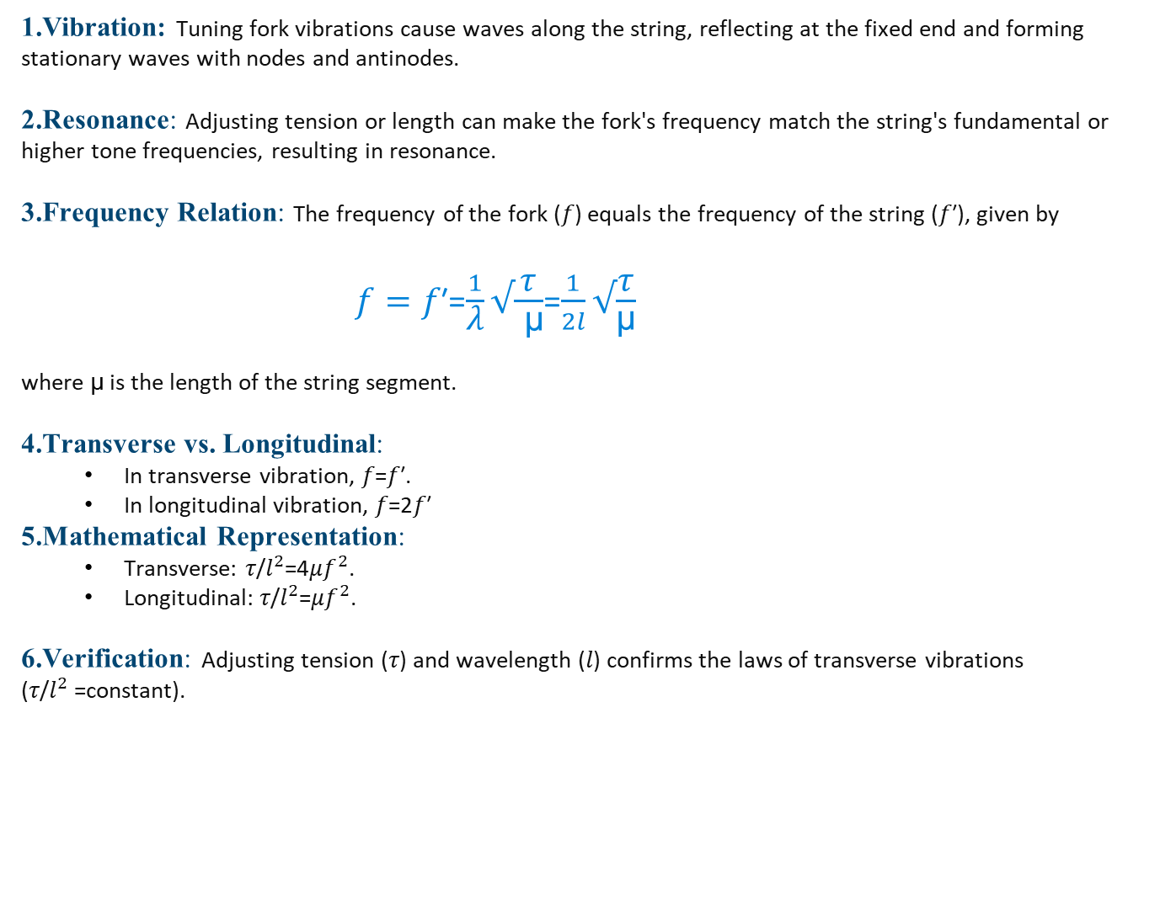
1.Vibration: Tuning fork vibrations cause waves along the string, reflecting at the fixed end and forming stationary waves with nodes and antinodes.
2.Resonance: Adjusting tension or length can make the fork's frequency match the string's fundamental or higher tone frequencies, resulting in resonance.
3.Frequency Relation: The frequency of the fork (𝑓) equals the frequency of the string (𝑓′), given by
$f=\text{f}\text{′}$=$\frac{1}{\text{λ}}√\frac{\text{τ}}{ \text{μ}}$=$\frac{1}{2l}√\frac{\text{τ}}{\text{μ}}$
where $\text{μ}$is the length of the string segment.
4.Transverse vs. Longitudinal:
In transverse vibration, 𝑓=𝑓′.
In longitudinal vibration, 𝑓=2𝑓′
5.Mathematical Representation:
Transverse: 𝜏/$l^{2}$=4𝜇$f^{2}$.
Longitudinal: 𝜏/$l^{2}$=𝜇$f^{2}$.
6.Verification: Adjusting tension (𝜏) and wavelength (𝑙) confirms the laws of transverse vibrations (𝜏/$l^{2}$=constant).
Notes:
Here in the theory part the starting with ohms law
For unknown resistance Rx tools are
For series resistance the formula is Rs = R1 + R2 + ... + RN
For series resistance Insight Total resistance in series is the sum of individual resistances.
5th is illustrations here is the diagrams for two resistors

Slide 6
02
Apparatus

Slide 7
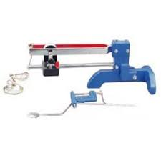
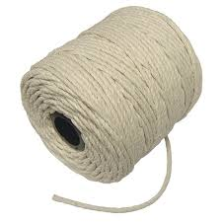
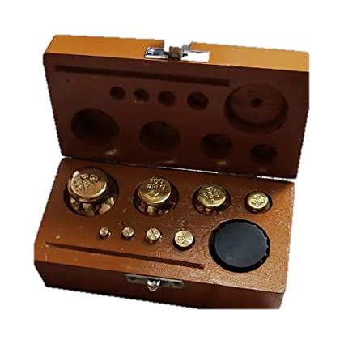
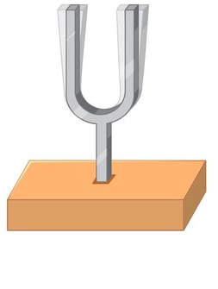
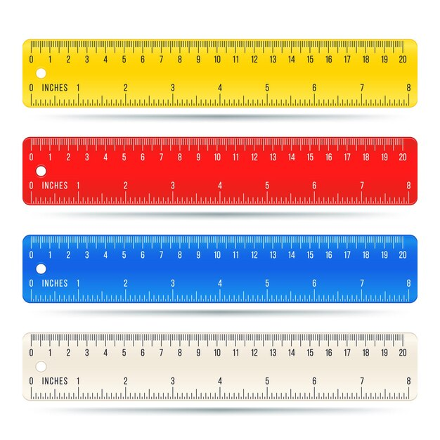
Melde’s apparatus
string
weight box
Tuning Fork
Meter Scale
10%
45K

Slide 8
03
Procedure

Slide 9
Set up: Clamp tuning fork, attach thread to prong, hang scale pan, add weights for light tension.
Excite tuning fork vibration.
Adjust weight for maximum loops, fixed nodal points, and equal loop length.
Measure distance between successive nodes, count loops.
Increase weight by 5 gm, repeat steps 2-4 for new segment length.
Repeat for different fork vibration mode (turn fork 90°).
Determine weight and length of string, find mass per unit length of thread and scale pan mass.
Calculate fork frequency using equations (1) and (2).

Slide 10
4
Experimental Data
Notes:
Thank you Jarifur Rahman for giving me opportunity to explain the next part of our presentation which is experimental data.

Slide 11
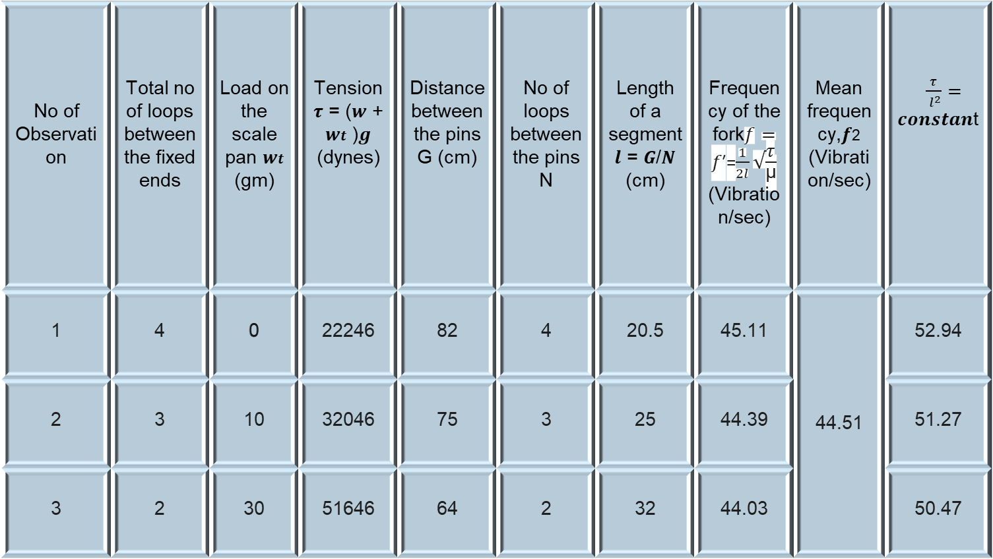
No of Observation | Total no of loops between the fixed ends | Load on the scale pan 𝒘𝒕 (gm) | Tension 𝝉 = (𝒘 + 𝒘𝒕 )𝒈 (dynes) | Distance between the pins G (cm) | No of loops between the pins N | Length of a segment 𝒍 = 𝑮/𝑵 (cm) | Frequency of the fork$f=\text{f}\text{′}$=$\frac{1}{2l}√\frac{\text{τ}}{\text{μ}}$ (Vibration/sec) | Mean frequency,𝒇2 (Vibration/sec) | $\frac{τ}{{ l}^{2}}=$ 𝒄𝒐𝒏𝒔𝒕𝒂𝒏t
1 | 4 | 0 | 22246 | 82 | 4 | 20.5 | 45.11 | 44.51 | 52.94
2 | 3 | 10 | 32046 | 75 | 3 | 25 | 44.39 |  | 51.27
3 | 2 | 30 | 51646 | 64 | 2 | 32 | 44.03 |  | 50.47
Notes:
In the slide we can see that we measured the temperature for water and liquid . We measured the temperature within 45 min.
For obs no. 1 . Time taken is o the water temp is 75 and liquid temp is also 75
For obs no. 11 . Time taken is 10 the water temp is 64 and liquid temp is also 60

Slide 12
5
Analysis and Calculation

Slide 13
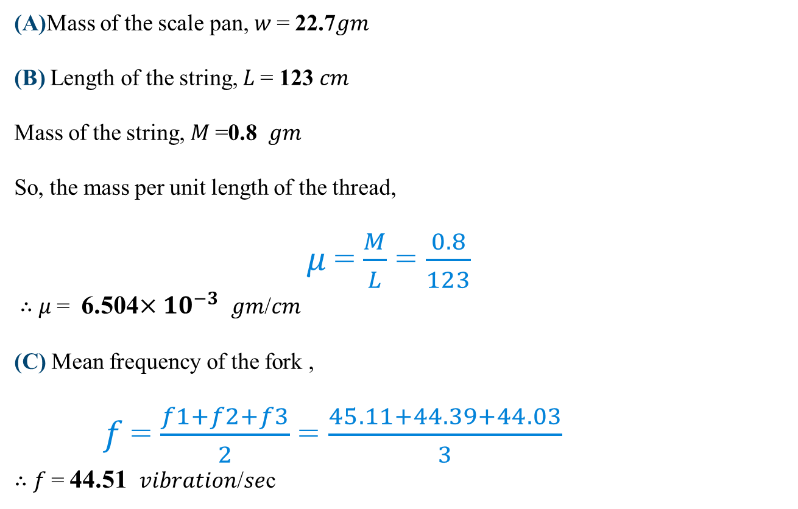
(A)Mass of the scale pan, 𝑤 = 22.7𝑔𝑚
(B) Length of the string, 𝐿 = 123 𝑐𝑚
Mass of the string, 𝑀 =0.8 𝑔𝑚
So, the mass per unit length of the thread,
𝜇 = $\frac{M}{L}$ = $\frac{0.8}{123}$
∴ 𝜇 = 6.504$×{10}^{−3}$ 𝑔𝑚/𝑐𝑚
(C) Mean frequency of the fork ,
𝑓 = $\frac{f1+f2+f3}{2}$ = $\frac{45.11+44.39+44.03}{3}$
∴ 𝑓 = 44.51 𝑣𝑖𝑏𝑟𝑎𝑡𝑖𝑜𝑛/𝑠𝑒c

Slide 14
06
Result

Slide 15
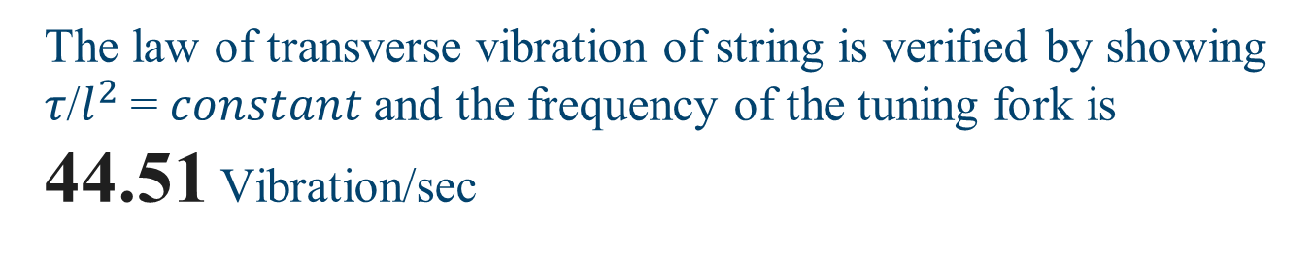
The law of transverse vibration of string is verified by showing 𝜏/$l^{2}$= 𝑐𝑜𝑛𝑠𝑡𝑎𝑛𝑡 and the frequency of the tuning fork is 44.51 Vibration/sec

Slide 16
7
Discussion

Slide 17
Experiment determined tuning fork frequency 45.78 Hz
Verified laws of transverse vibration with Melde's experiment
Learned about nodes, loops, and resonant frequencies
Used careful ruler positioning to minimize measurement errors
$20K
10%
45K

Slide 18
8
Resources

Slide 19
Fundamental of Physics
Wikipedia Resources
Khan Academy Physics ( You Tube )
Academic Lecture Materials

Slide 20


